Slide 1
Employe Behavior
Anticipate employee behavior

Slide 2
CONTENTS
Introduction & DESCRIBE DATA
MOTIVATION
Data Exploration
Baseline Model
Data prep &Experimentation
precision , recall and fbeta
solve the Imbalance
Conclusion

Slide 3
Introduction:
Intended for HR analytics where companies can predict which employee is likely to leave this company based on several characteristics.

Slide 4

DESCRIBE DATA:
I have 10 columns and 14999 rows.
Satisfaction level | employee satisfaction level
Last evaluation | employee last evaluation
Number project | Number of employee projects
Average monthly hours | Average monthly hours spent by an employee
Time spend company | How much time does he/she spend in the company
Work accident | The number of accidents that occurred at work
left | Will he quit or continue
promotion_last_5years | Did he have the promotion last 5 years?
Department | In which department does he/she work
Salary | How much is the salary

Slide 5
MOTIVATION
Employee behavior predicts who will stay and who will leave based on several characteristics.
left :I would expect as a target
Features :All columns except (left column)

Slide 6
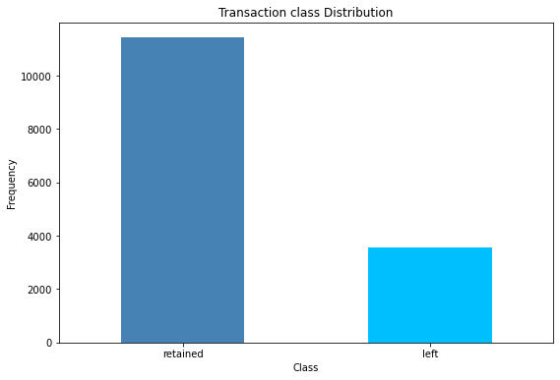
EDA
The number of employees who left the company and the number of those who stayed

Slide 7
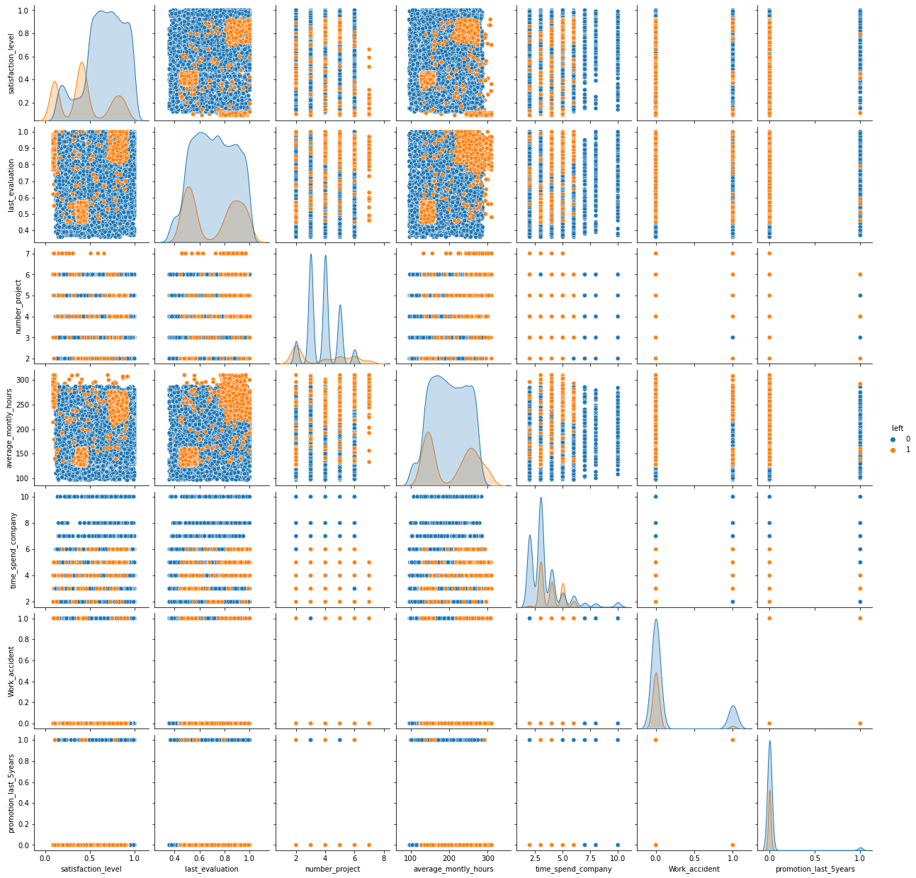
EDA
The relationship between target and Features

Slide 8
Baseline Model
Train score:
0.767
test score:
0.754
fbeta_score:
0.415

Slide 9
Expr4 Decisio trees
Train score:1.0
test score: 0.971
Expe5: using GridsearchCV to Decision trees
Expr3: using grid search Logistic Regression
Train score:0.7908
test score: 0.7853
Train score:0.9839
test score: 0.975
Expe6:Random forest
Expr2: with scaling(minmax
scaler)
Train score:0.9998
test score: 0.9823
Train score:0.7908
test score: 0.7853
Expe7:using GridsearchCV to Random forest
Expr1: with All the data
Train score:0.7901
test score: 0.7806
Train score:0.9912
test score: 0.9796
Experimentation

Slide 10
Expe10: using Voting(Max)
Train score:0.9885
test score: 0.9643
Expe11: using Voting(Average)
Expe9:using GridsearchCV to KNN
Train score:0.9933
test score: 0.968
Train score:0.9714
test score: 0.943
Expe12: Stacking Classifier
Expe8:using knn model
Train score:1.0
test score: 0.983
Train score:0.9549
test score: 0.9333
Experimentation

Slide 11

precision , recall and fbeta
20%
50%
90%
100%
Logistic Regression
KNN
randomforest
stacked
fbeta_score:0.431
Recall score:0.331
Precision score:0.576
fbeta_score:0.847
Recall score:0.906
Precision score:0.859
fbeta_score:0.803
Recall score:0.939
Precision score:0.985
fbeta_score:0.962
Recall score:0.939
Precision score:0.988

Slide 12
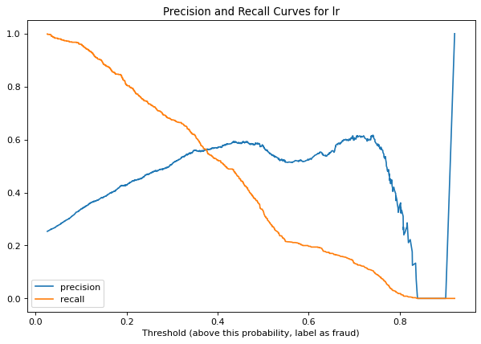
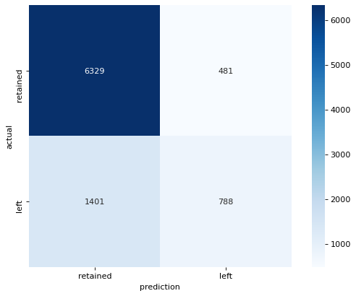
precision curve, recall curve and confusion matrix for lr

Slide 13
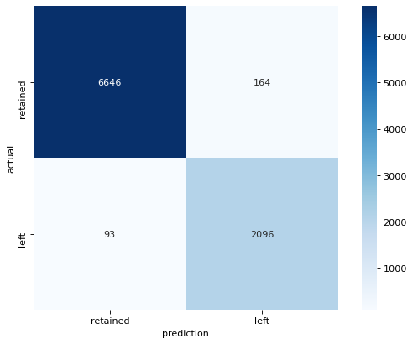
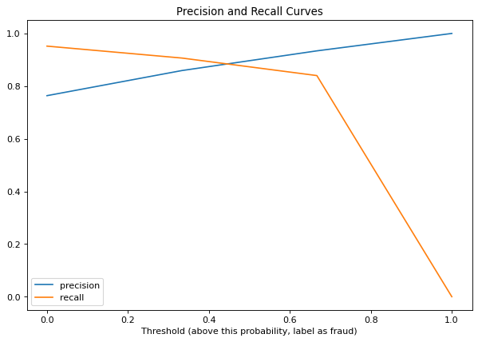
precision curve, recall curve and confusion matrix for KNN

Slide 14
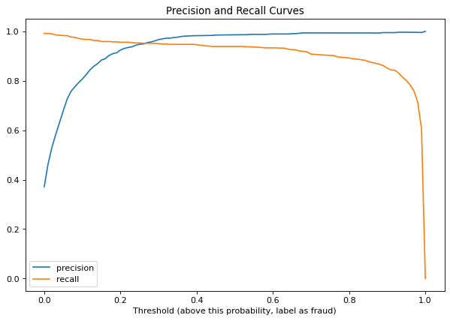

precision curve, recall curve and confusion matrix for randomforest

Slide 15
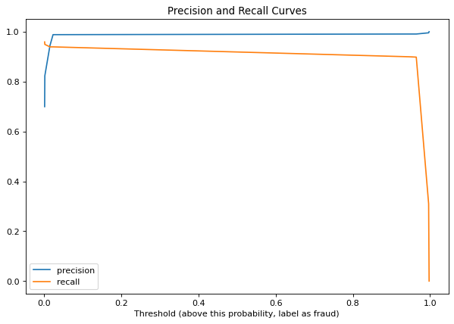
precision curve, recall curve and confusion matrix for stacked

Slide 16
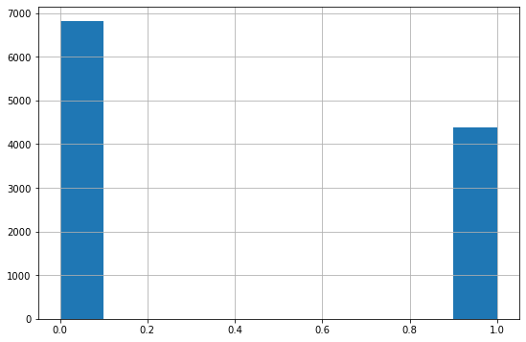
solve the Imbalance Before model training(oversampling)
F1 before: 0,422
F1 after:0.594

Slide 17
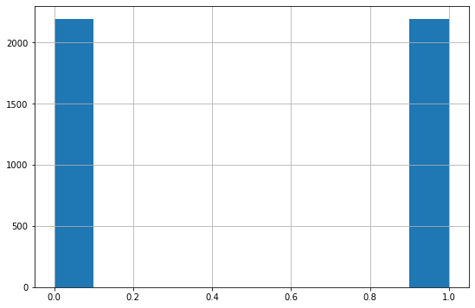
solve the Imbalance Before model training(undersampling)
F1 before: 0,422
F1 after:0.603

Slide 18
Grid Search(CV LogisticRegression) undersampling imbalance
F1:0.616

Slide 19
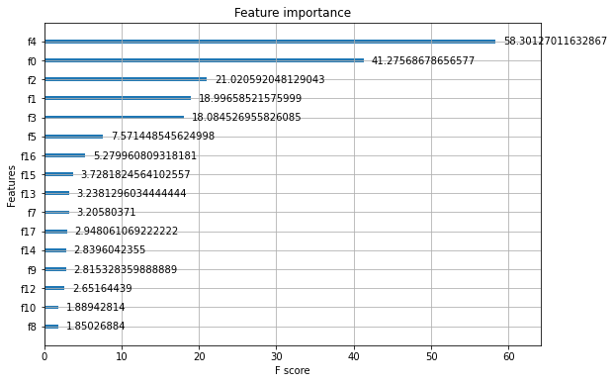
XGBClassifier
F1:0.931

Slide 20
XGBClassifier (RandomizedSearchCV)
F1:0.946

Slide 21
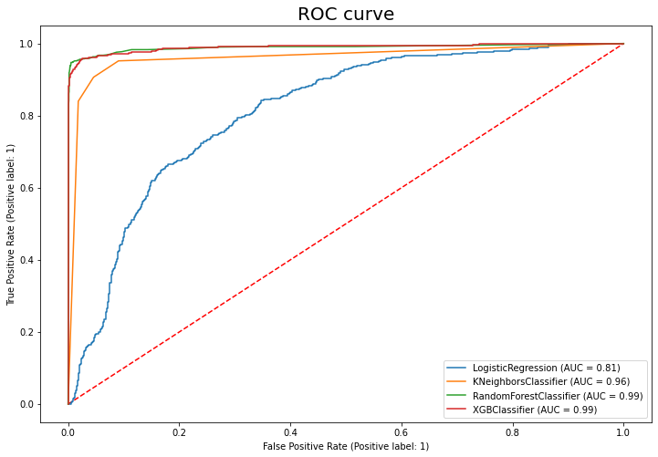
ROC

Slide 22
Conclusion
randomforest and stacked is the best model
randomforest
fbeta_score:0.874
stacked
fbeta_score:0.962
solve the Imbalance Before model training(undersampling)
XGBClassifier (RandomizedSearchCV)
F1:0.946

Slide 23
Thank You

